Slide 1


Predicting Force from Sensor Data
Lucas Khoo Kar Hoo

Slide 2
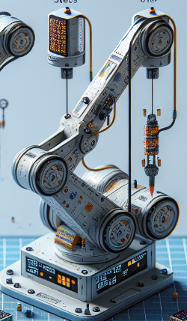
Introduction
Objective: Develop a predictive model to estimate force using stress sensor data.
Background:
Robotic Arms: Widely used in manufacturing, assembly, and precision tasks where accurate force control is crucial.
Force Measurement Challenge: Direct measurement of force can be difficult due to space constraints and the need for compact sensors.

Slide 3
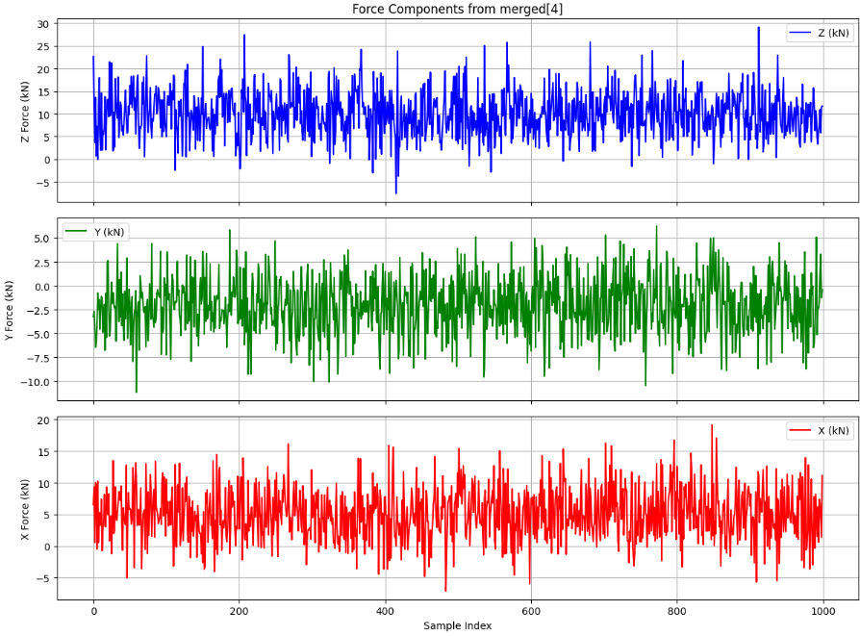
Data Preprocessing + EDA
-Four lab test files with stress (Features) and force data (Target). (df1 – df4)
-df1 &df2-> Training data
-df3 -> Validation Data
-df4 -> Testing Data
-df5 -> Submission data with no target

Slide 4
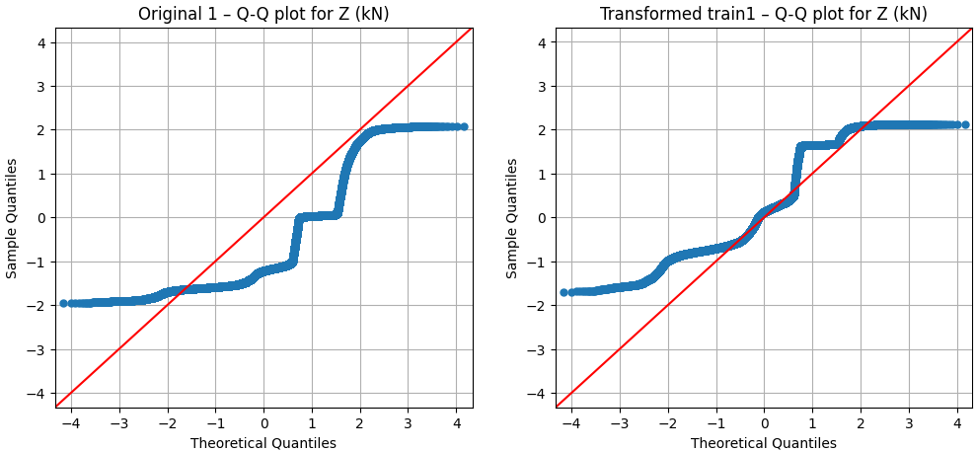
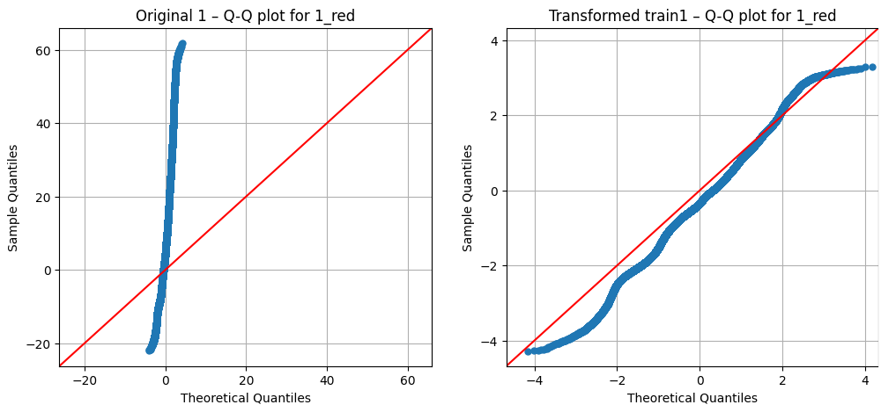
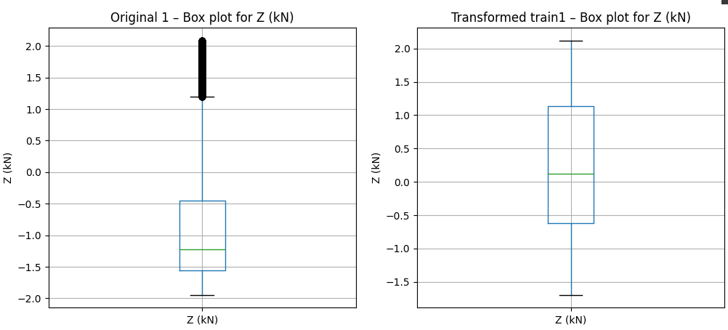
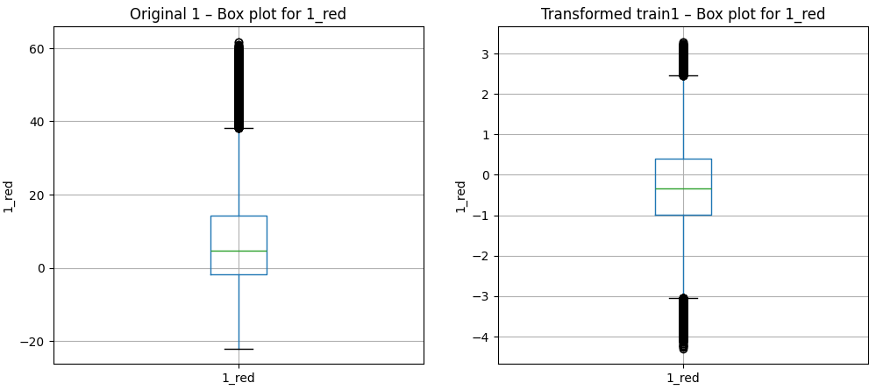
Data Preprocessing + EDA (Yeo-Johnson Transformation)
Notes:
1| Right skewness –close to normal data. (But transformation not fully eliminated the discrete nature of the load, with continuous variation only introduced by factors like uncertainty or grip strength increments-→ since this is a target data
2|Extreme Non-Normality- from highly non normal/heavy concentrated data point to---→ more normal distribution, even though the transformed data still have a bit of left skewness. + slight Platykurtic
*A slope greater than 1 means the transformed data has a larger standard deviation than the theoretical normal.
#IMPORTANTTheoretical Line: With fit=False, the Q-Q plot uses a strict 45-degree line
#that represents the theoretical quantiles of a normal distribution. This provides a direct comparison between the sample data and the theoretical distribution.

Slide 5
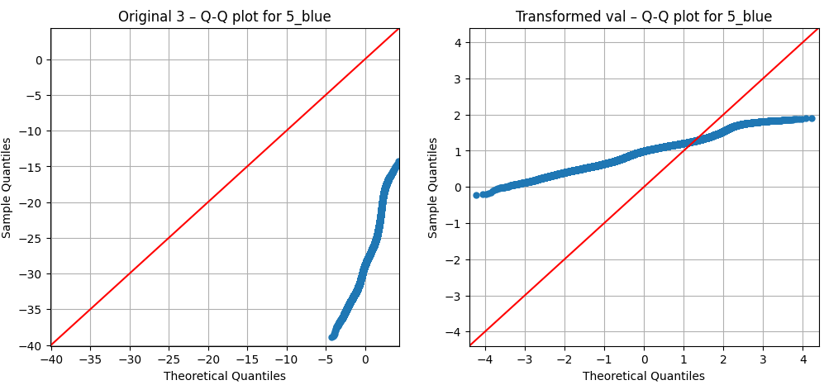
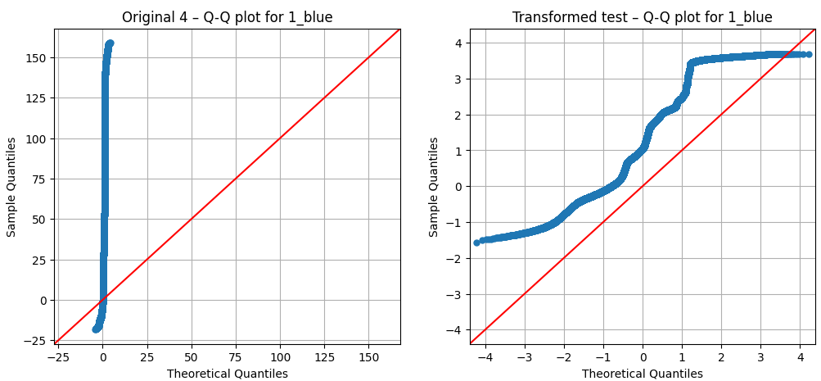
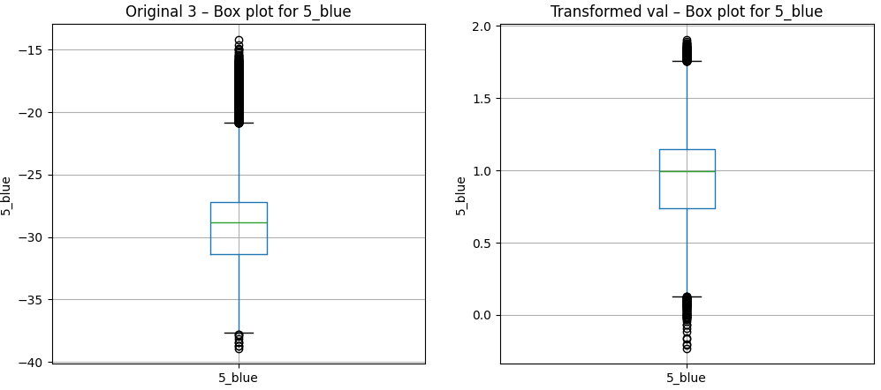
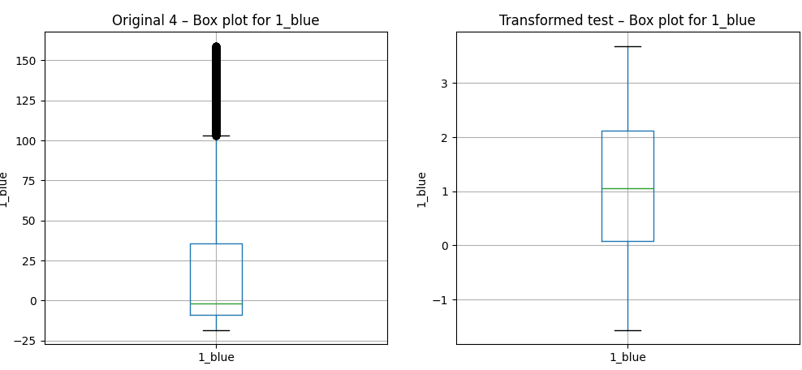
Data Preprocessing + EDA (Yeo-Johnson Transformation)
Notes:
1| Right skewness→ Close to normal
2|Extreme Non-Normality- from highly non normal/heavy concentrated data point to---→ more normality (Even though still have slight right skewness and light tailness/platykurtosis
##LSTMs and DNNs (Neural Networks): By making input features more symmetric and normal-like (mean near 0, variance near 1 after standardization), the transformation improves gradient flow during backpropagation..
##Decision Trees: While tree splits are based on feature order (preserved by monotonic transformations), a more regular distribution can sometimes lead to more stable split point selections and potentially better performance

Slide 6
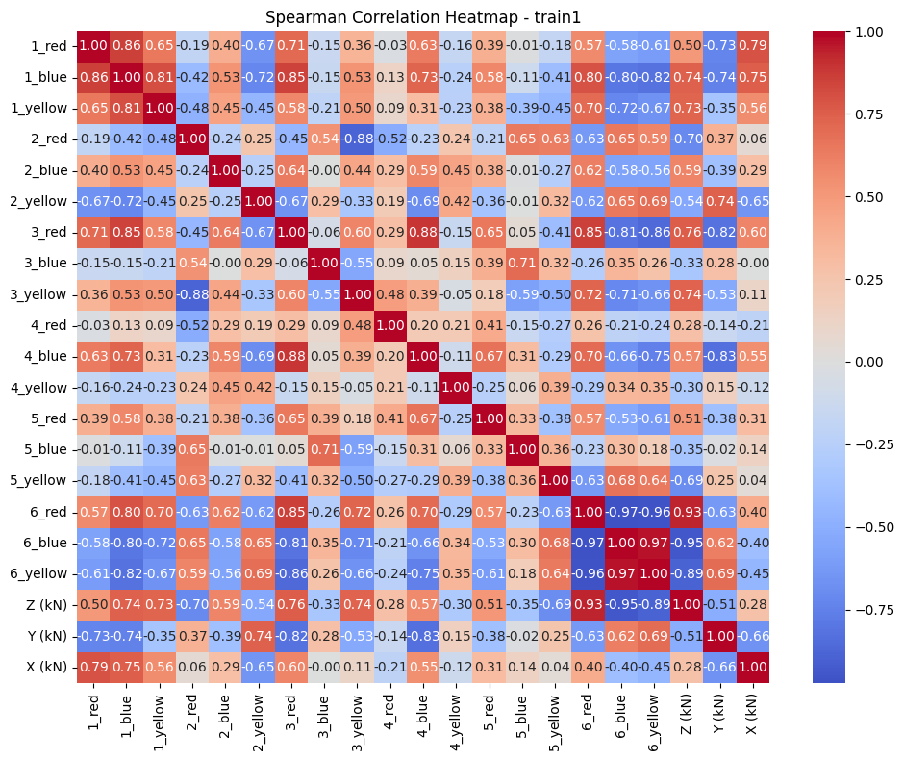
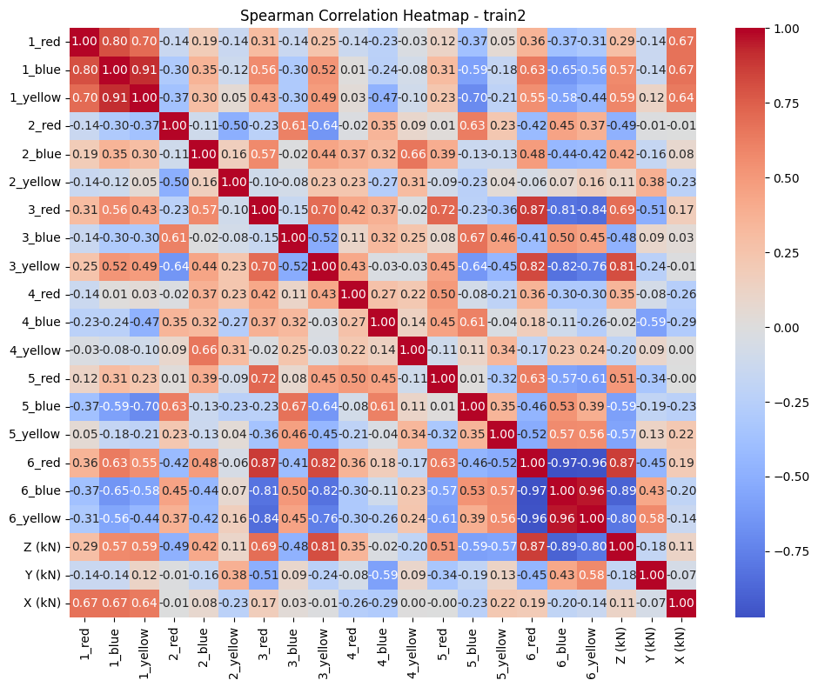
Data Preprocessing + EDA (Spearman Correlation-Train)
Notes:
Feature no 6 (red, yellow, blue) generally have strong correlation with Z and Y force measurement. While, feature 1 have strong correlation with Z force measurement.
High correlations between input features 1. (Might suggest some level of redundancy, although Spearman correlation doesn't directly measure multicollinearity in the same way as Pearson correlation.

Slide 7
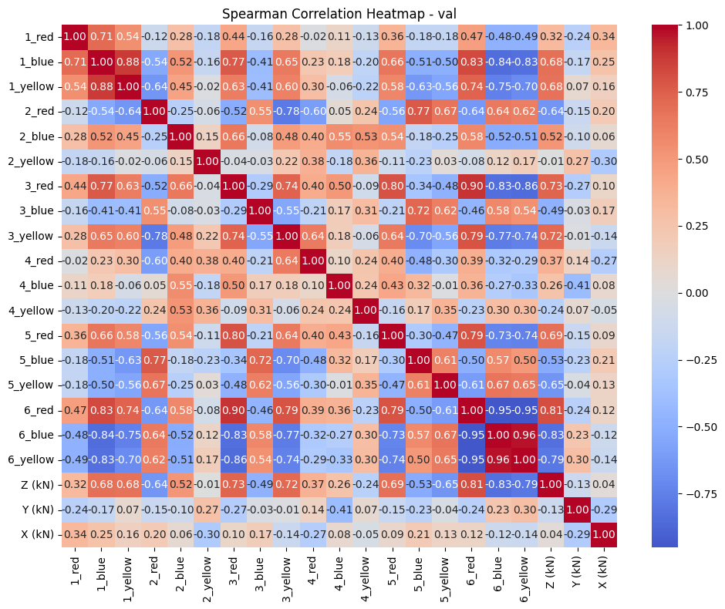
Data Preprocessing + EDA (Spearman Correlation-Val, Test)
Notes:
Feature no 6 (red, yellow, blue) generally have strong correlation with Z and Y force measurement. While, feature 1 have strong correlation with Z force measurement.
High correlations between input features 1. (Might suggest some level of redundancy, although Spearman correlation doesn't directly measure multicollinearity in the same way as Pearson correlation.

Slide 8
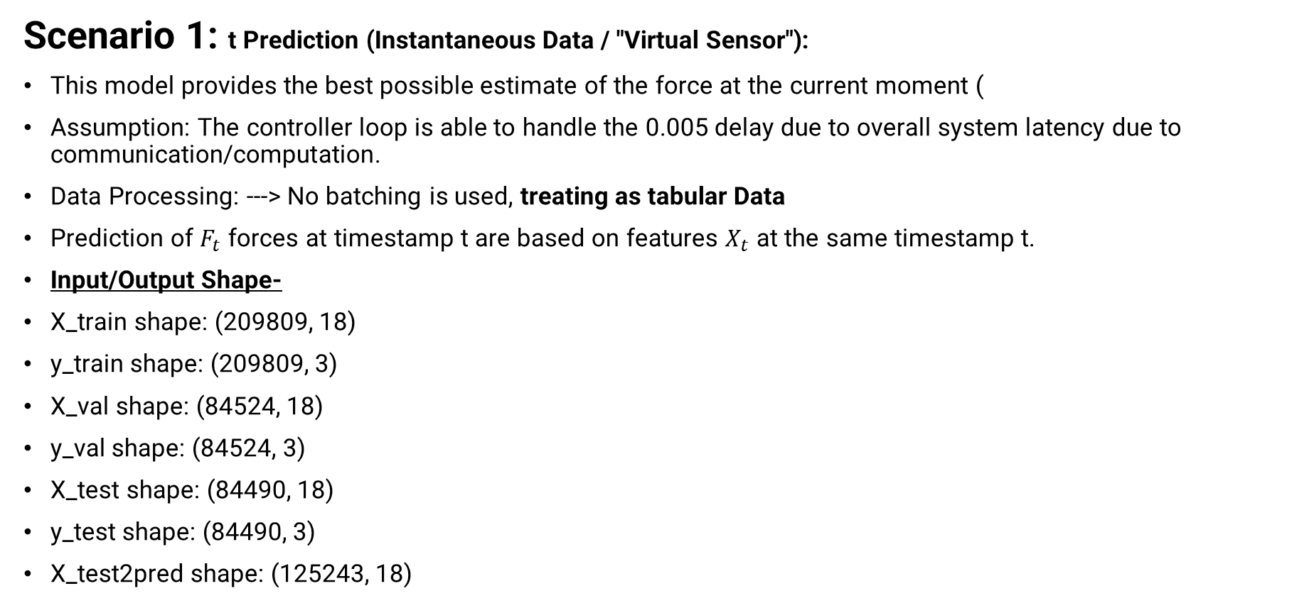
Data Preprocessing + EDA
Scenario 1: t Prediction (Instantaneous Data / "Virtual Sensor"):
This model provides the best possible estimate of the force at the current moment (
Assumption: The controller loop is able to handle the 0.005 delay due to overall system latency due to communication/computation.
Data Processing: ---> No batching is used, treating as tabular Data
Prediction of $F_{t}$ forces at timestamp t are based on features $X_{t}$ at the same timestamp t.
Input/Output Shape-
X_train shape: (209809, 18)
y_train shape: (209809, 3)
X_val shape: (84524, 18)
y_val shape: (84524, 3)
X_test shape: (84490, 18)
y_test shape: (84490, 3)
X_test2pred shape: (125243, 18)

Slide 9
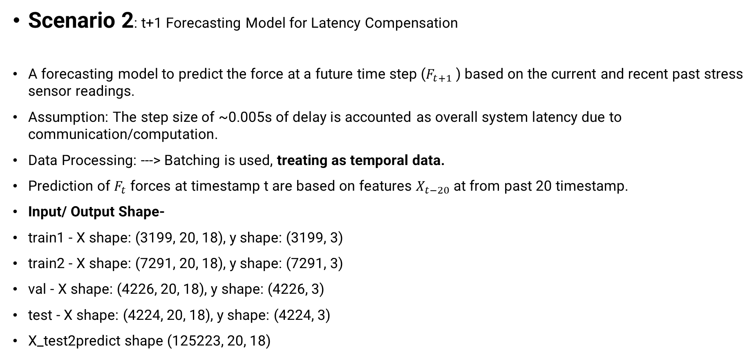
Data Preprocessing + EDA
A forecasting model can be designed to predict the force at a future time step (Ft+prediction_horizon) based on the current and recent past stress sensor readings The key is to set your prediction_horizon to effectively compensate for the system's latency
Scenario 2: t+1 Forecasting Model for Latency Compensation
A forecasting model to predict the force at a future time step ($F_{t+1}$ ) based on the current and recent past stress sensor readings.
Assumption: The step size of ~0.005s of delay is accounted as overall system latency due to communication/computation.
Data Processing: ---> Batching is used, treating as temporal data.
Prediction of $F_{t}$ forces at timestamp t are based on features $X_{t−20}$ at from past 20 timestamp.
Input/ Output Shape-
train1 - X shape: (3199, 20, 18), y shape: (3199, 3)
train2 - X shape: (7291, 20, 18), y shape: (7291, 3)
val - X shape: (4226, 20, 18), y shape: (4226, 3)
test - X shape: (4224, 20, 18), y shape: (4224, 3)
X_test2predict shape (125223, 20, 18)
train1 - X shape: (3199, 20, 18), y shape: (3199, 3) train2 - X shape: (7291, 20, 18), y shape: (7291, 3) val - X shape: (4226, 20, 18), y shape: (4226, 3) test - X shape: (4224, 20, 18), y shape: (4224, 3) X_test2predict shape (125223, 20, 18)

Slide 10
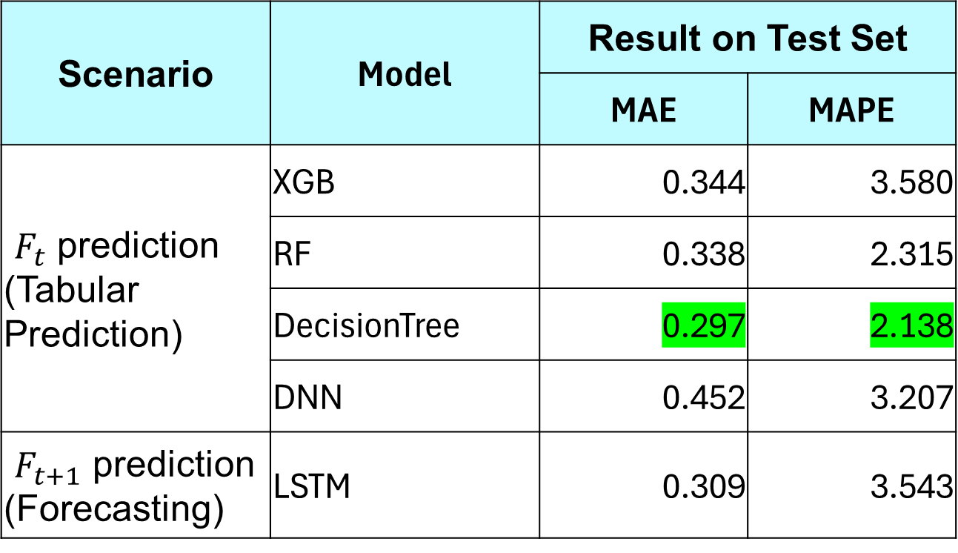
Result
Scenario | Model | Result on Test Set
 |  | MAE | MAPE
$F_{t}$ prediction (Tabular Prediction) | XGB | 0.344 | 3.580
 | RF | 0.338 | 2.315
 | DecisionTree | 0.297 | 2.138
 | DNN | 0.452 | 3.207
$F_{t+1}$ prediction (Forecasting) | LSTM | 0.309 | 3.543

Slide 11
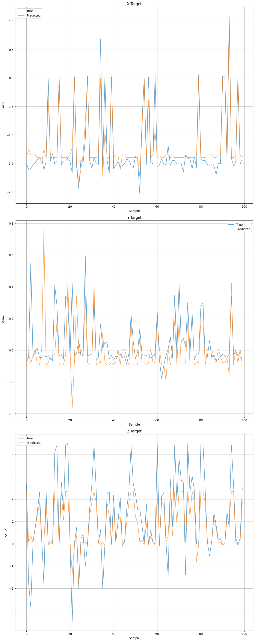
Scenario 1: Decision Tree (Test Set Prediction)

Slide 12
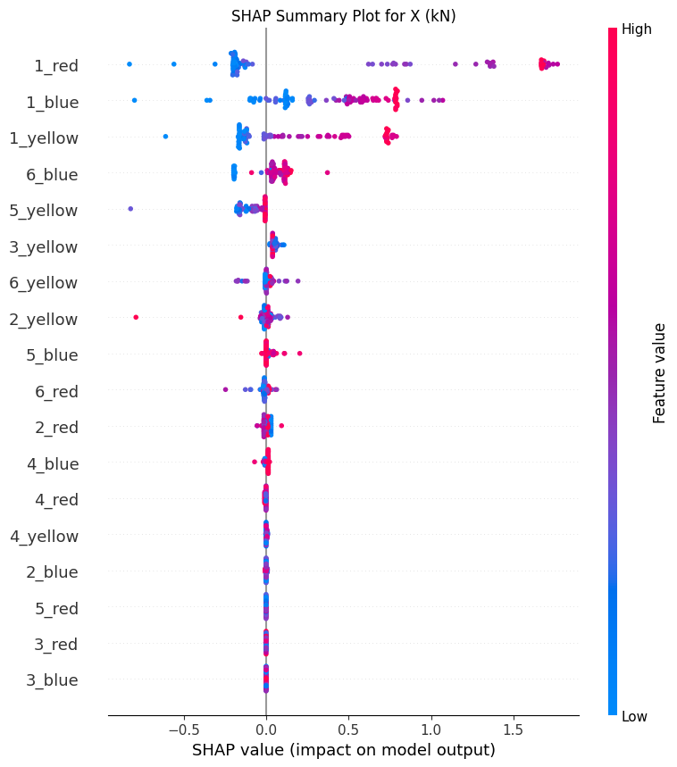
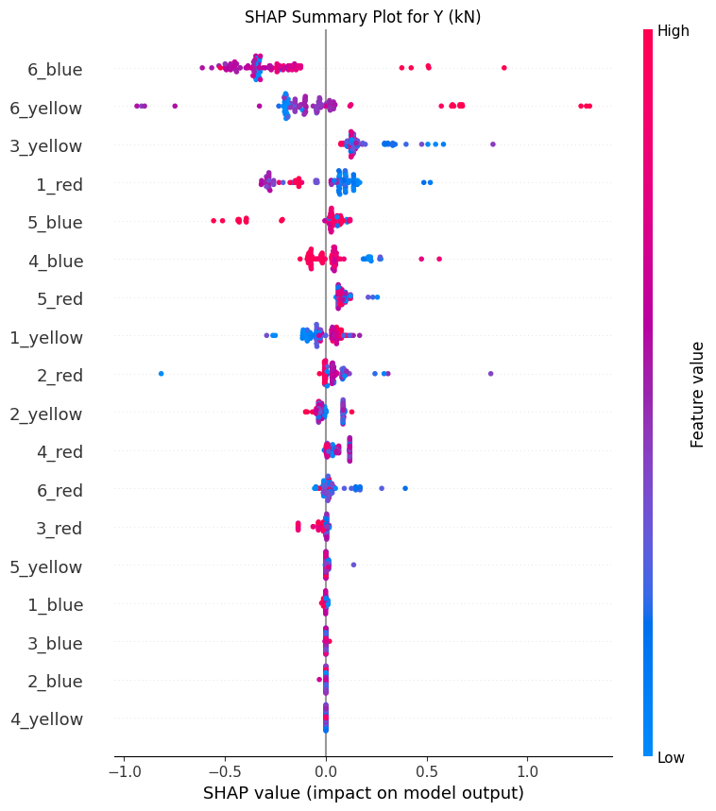
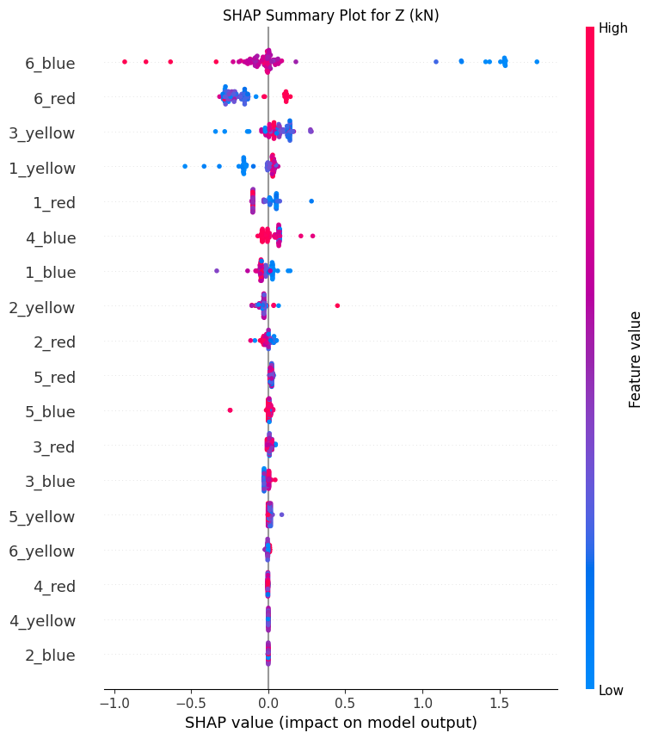
Scenario 1: Decision Tree (Test Set Prediction)
Notes:
As aligned with spearman correlation, feature number 6 (blue, yellow, red), has the biggest impact (-ve impact) on Y and Z force measurement. (kN); while the feature number 1 has strong =ve impact on X force measurement (kN)

Slide 13
Appendix- Best Hyperparameters
Model | Key Hyperparameters
DNN | n_layers: 5, learning_rate: 0.0011465, &lt;br> units_0: 16, activation_0: relu, dropout_rate_0: 0.35 &lt;br> units_1: 48, activation_1: sigmoid, dropout_rate_1: 0.45 &lt;br> units_2: 32, activation_2: tanh, dropout_rate_2: 0.45 &lt;br> units_3: 128, activation_3: relu, dropout_rate_3: 0.15 &lt;br> units_4: 48, activation_4: sigmoid, dropout_rate_4: 0.25 &lt;br> units_5: 80, activation_5: tanh, dropout_rate_5: 0.15
XGBoost | colsample_bytree: 0.8, learning_rate: 0.13922, max_depth: 11, n_estimators: 583, random_state: 42, subsample: 1.0, n_jobs: 3, enable_categorical: False, verbosity: 1, objective: reg:squarederror
RF | max_depth: 30, max_features: 'log2', min_samples_leaf: 5, min_samples_split: 50, n_estimators: 900, random_state: 42, n_jobs: 3,, criterion: 'squared_error', min_impurity_decrease: 0.0, min_samples_split: 50, min_weight_fraction_leaf: 0.0
DecisionTree | max_depth: 9, min_samples_leaf: 3, min_samples_split: 4, random_state: 42, n_jobs: 3, ccp_alpha: 0.0, criterion: 'squared_error', min_impurity_decrease: 0.0, min_samples_leaf: 3, min_samples_split: 4, min_weight_fraction_leaf: 0.0, splitter: 'best'
LSTM | rnn_type: LSTM, num_rnn_layers: 3, rnn_units: 64, return_sequences: 1, bidirectional: 1, dense_initializer: he_normal, dense_activation: leaky_relu, dense_units: 56, num_dense_layers: 2, dense_dropout: 0.35

